Slide 1
Stage 2, Bay 3 Spock's Goatee Course Designer: Eric Beerbaum
Spock's Goatee is a 26 round unlimited course. There are 11 paper targets and 4 poppers. Paper must be neutralized and steel must fall to score. The start signal is audible.
The Handgun start position is standing in box A with wrists below belt. Handgun loaded and holstered. If you do not have a holster, the pistol will be loaded and placed on barrel 1. The PCC start position is standing in box A. PCC loaded, safety on, stock touching belt.
On the audible start signal, flip one of the randomized tiles on barrel 2. If the tile is black, brown paper and Red steel are shoots and the rest are no-shoots. If the tile is white, white paper and White steel are shoots and the rest are no-shoots. Engage appropriate targets from within the shooting areas.

Slide 2
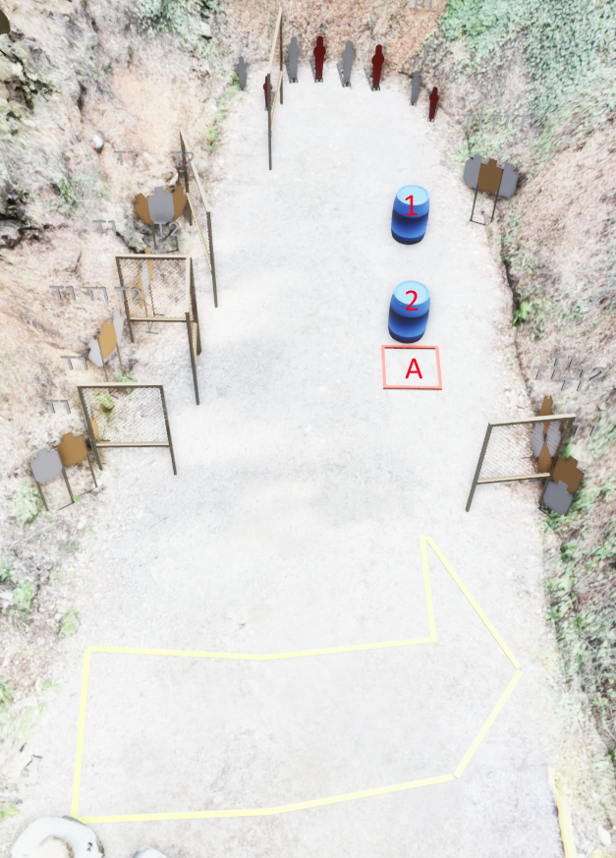
 | Stage 2, Bay 3 Spock's Goatee Course Designer: Eric Beerbaum

